Slide 1

G2M Insight for Cab Investment Firm
Company: XYZ
Date: 21/06/2022

Slide 2
Agenda
Executive Summary
Problem Statement
Approach
EDA
EDA Summary
Hypothesis Testing
Recommendations

Slide 3
Description
XYZ – Private equity firm – Planning for an investment in cab industry due to its remarkable growth
Helping XYZ firm by providing appropriate insights
Companies:
Pink Cab
Yellow Cab
Analysis:
Understanding the data
Data Visualization
Hypothesis tests
Model building

Slide 4
Datasets
There are four datasets which are as follows:
Cab_Data.csv – Includes details of the two cab companies. Total of 359392 observations.
City.csv – Includes details of the cities where the two cab companies are operating. Total of 20 observations.
Customer_ID.csv – Includes the details of the customers who used the cab services. Total of 49171 observations.
Transaction_ID.csv – Includes the details of the transactions made. Total of 440098 observations.

Slide 5
Exploratory Data Analysis

Slide 6
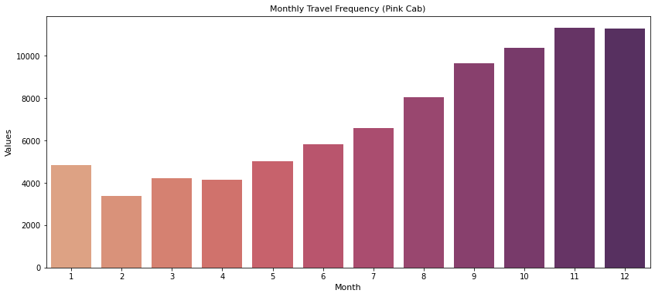
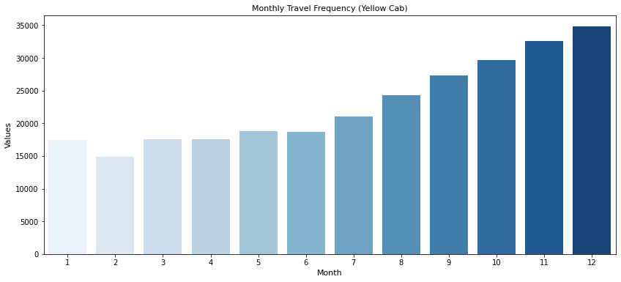
Monthly Transaction Analysis
Pink Cab
Yellow Cab
Yellow Cab has most travels as compared to the Pink Cab

Slide 7
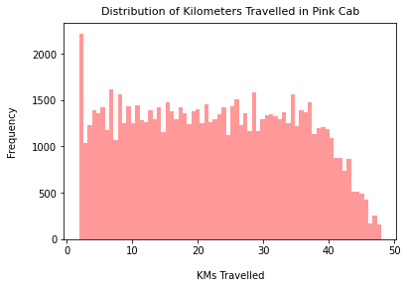
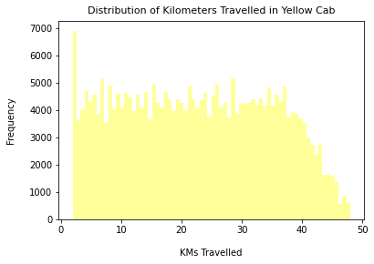
Kilometers Travelled
Pink Cab
Yellow Cab
From the plots, the rides are in between 2 kms to 48 kms for both cabs

Slide 8
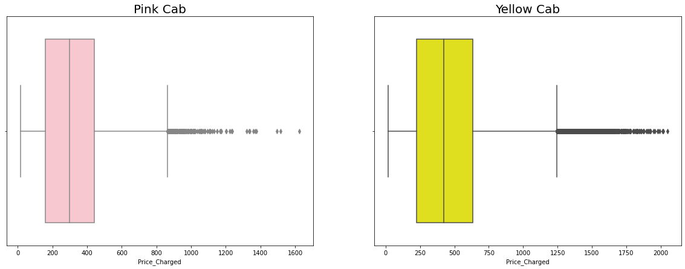
Price Range
The price range of Pink Cab is less than Yellow Cab
The outliers are the use of high-end cars

Slide 9
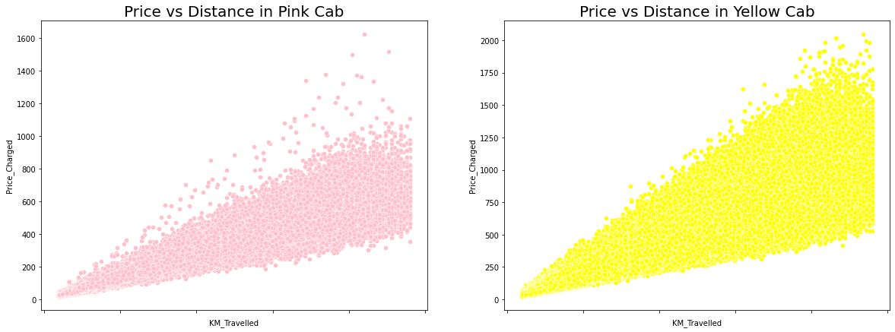
Price and Distance Relation
The price of the rides depends on the distance travelled
The correlation is positive in both pink and yellow cabs
The price of yellow cab is higher as compared to the one of pink cab

Slide 10
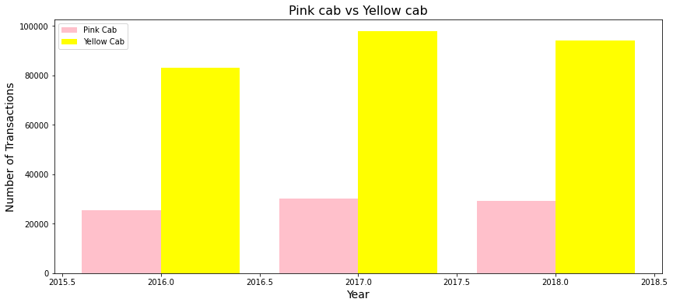
Number of Transactions
The plot shows that the transactions for yellow cab is higher than the pink cab

Slide 11
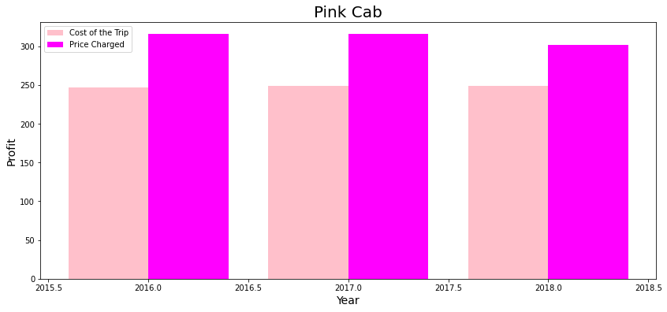
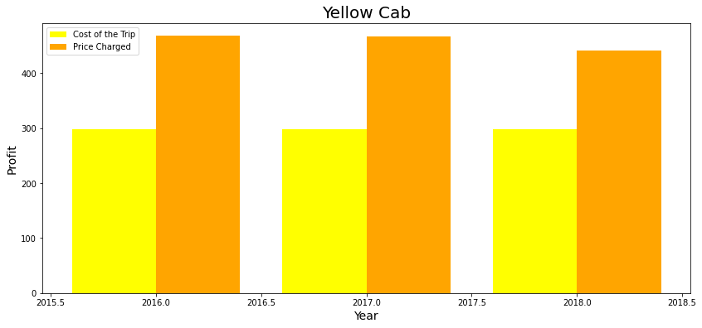
Profit Margin per Year
Pink Cab
Yellow Cab
The yellow cab has the highest profit margin

Slide 12
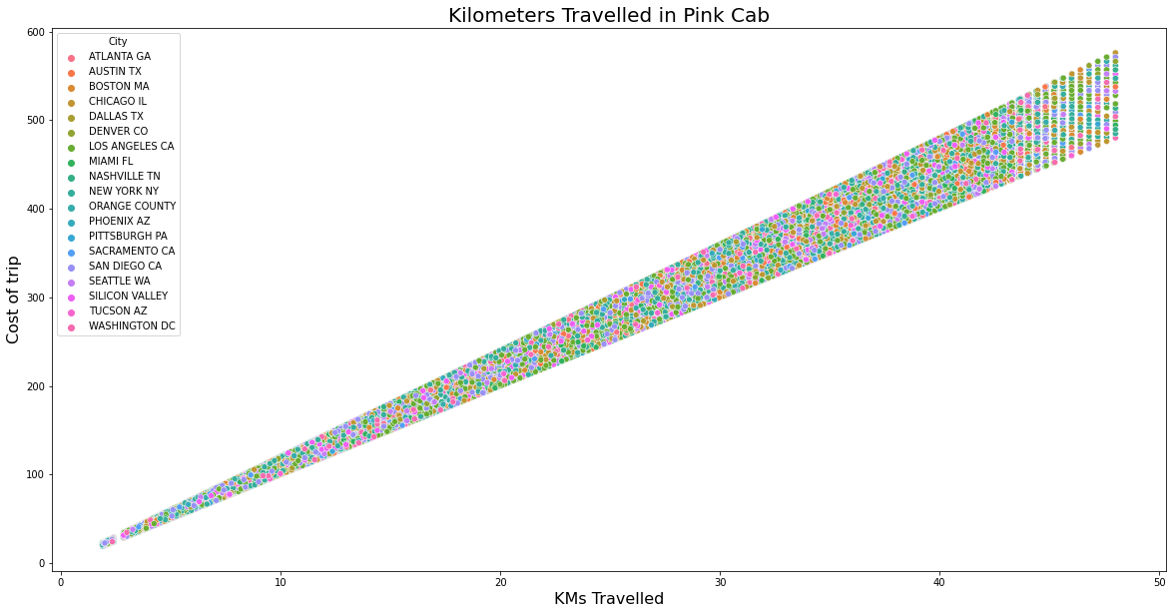
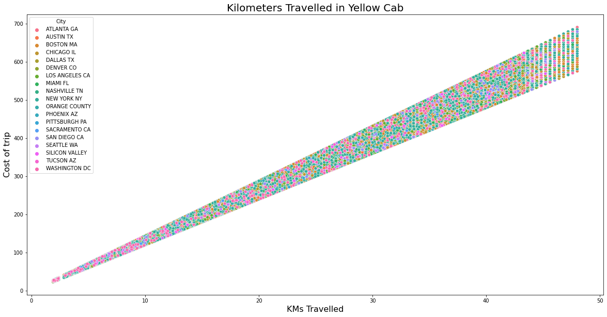
Cost of the Trips
The cost of trips for both the cabs are almost same

Slide 13
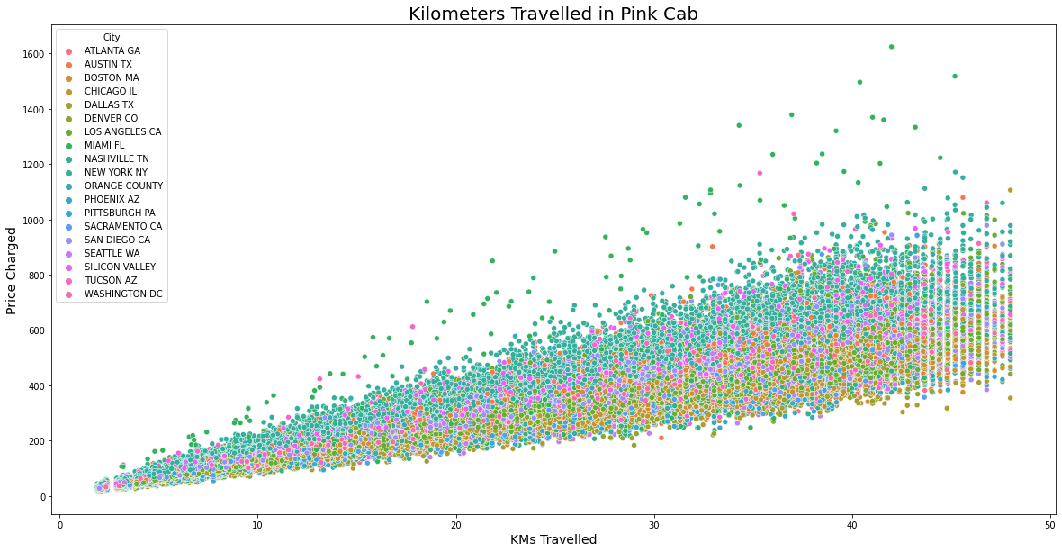
Price Charged in Each Cities: Pink Cab
There is same increase in prices with increase in distance for pink cab

Slide 14
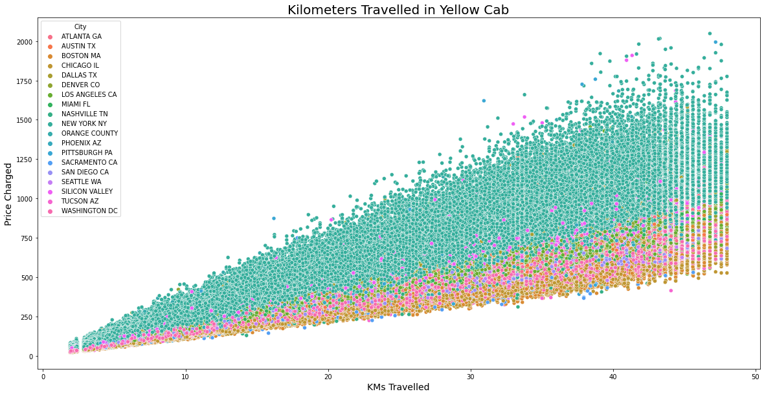
Price Charged in Each Cities: Yellow Cab
Yellow cab is used in New York most frequently than other cities

Slide 15
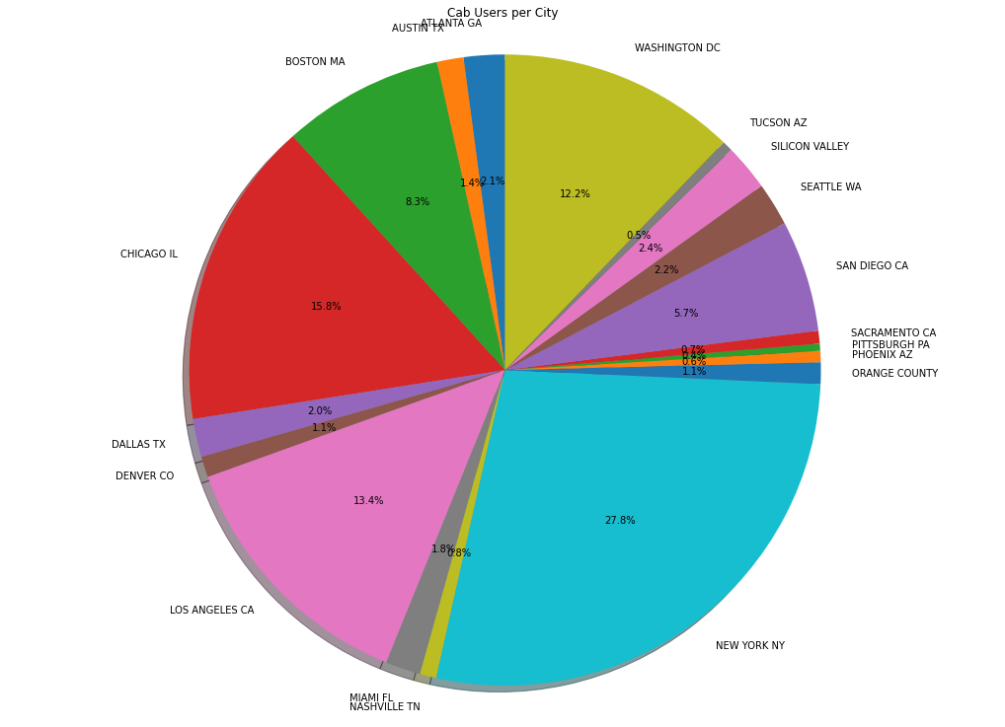
Cab Users per City
New York has the highest cab users with 27.8% users followed by Chicago with 15.8& and Los Angeles with 13.4%

Slide 16
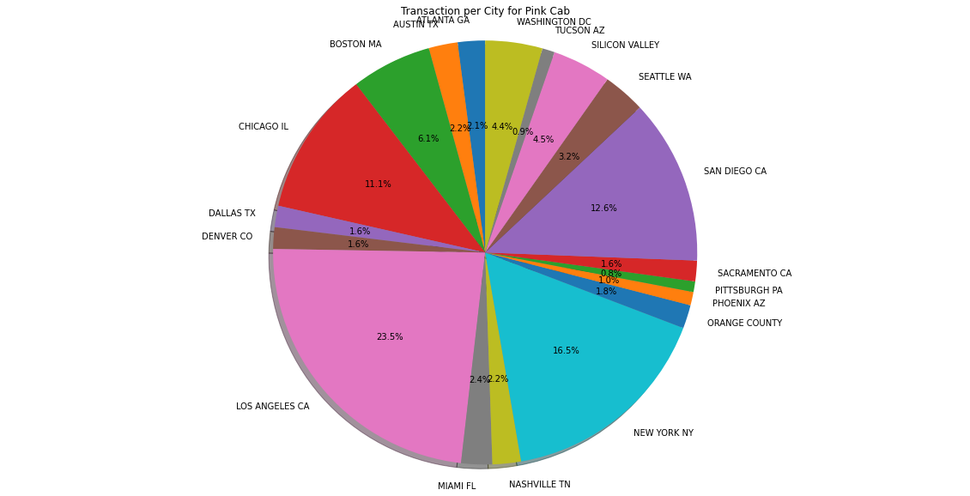
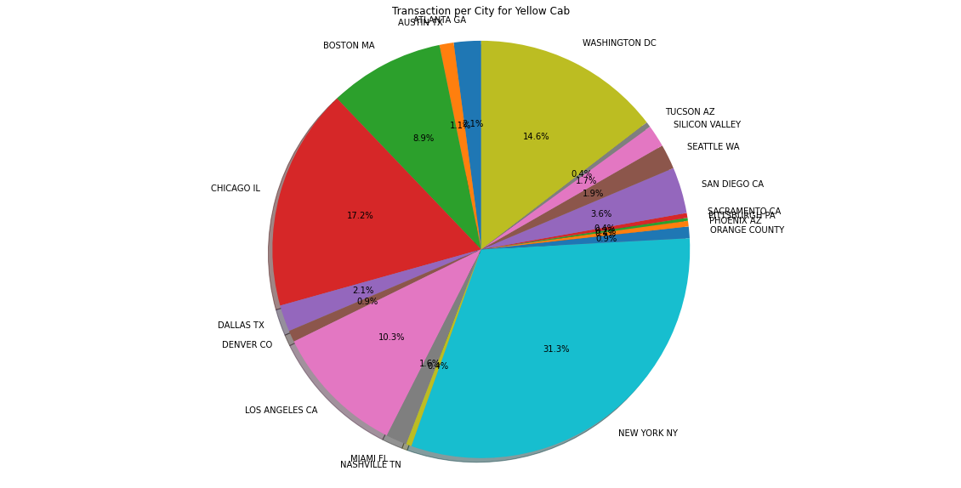
Transactions Made per City
Pink Cab
Yellow Cab
Transaction in Los Angeles for Pink Cab is the highest of 23.5%
Transaction in New York for Yellow Cab is the highest of 31.3%

Slide 17
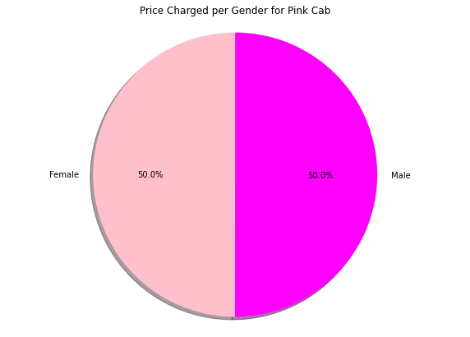
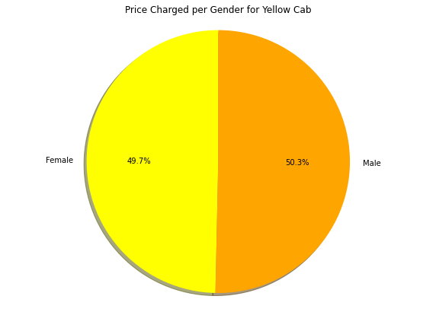
Price Charged per Gender
Pink Cab
Yellow Cab
The prices charged per gender in pink cab is exactly equal and yellow cab is almost equal

Slide 18
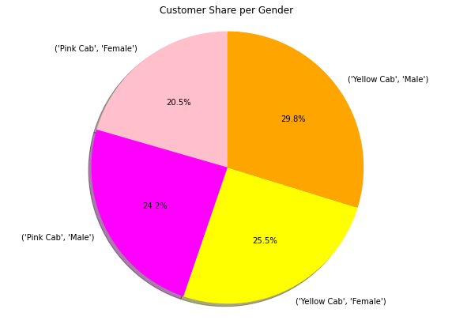
Customer Share per Gender
Yellow cab has the most female customers

Slide 19
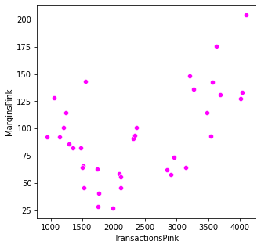
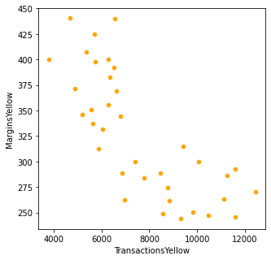
Monthly Margins
Pink Cab
Yellow Cab
There is an increase in margin with increase in transactions for Pink Cab
There is an decrease in margin with increase in transactions for Yellow Cab

Slide 20
EDA Summary

Slide 21
Pink Cab
The rides are in between 2 kms to 48 kms for both cabs
Price range between $150 - $450
In December, number of travels were around 11000
Transactions per year: 2016, 2017, 2018: 20000 – 40000
Increase in price with increase in distance for all cities
Charges equally for both the genders
Profit Margin is low
Increase in margin with increase in transactions

Slide 22
Yellow Cab
The rides are in between 2 kms to 48 kms for both cabs
Price range between $250 - $600
In December, number of travels were around 35000
Transactions per year: 2016, 2017, 2018: 80000 – 100000
Price charged in New York City is more as compared to other cities
Charges slightly less for female customers
Profit Margin is high
Decrease in margin with increase in transactions

Slide 23
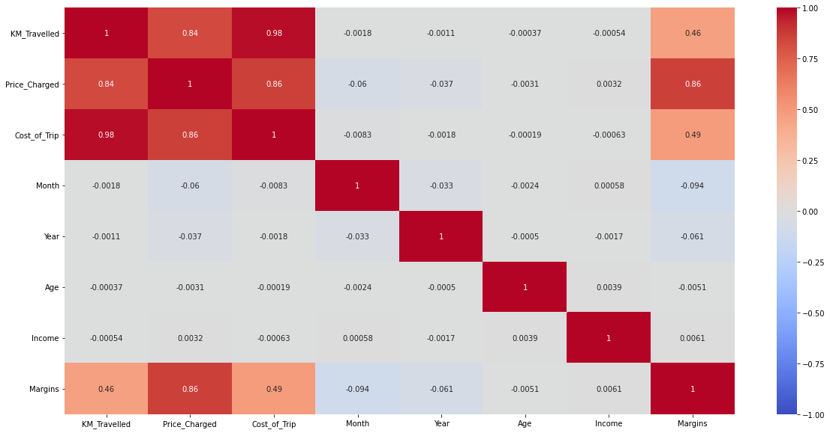
Correlation
Margins and price charged are correlated

Slide 24
Hypothesis Testing

Slide 25




Pink Cab
Margin regarding gender: No difference in margin between both genders.
Margin regarding all age groups: No difference in margin for all age groups.
Yellow Cab
Margin regarding gender: Difference in margin between both genders.
Margin regarding all age groups: Difference in margin for people older than 50 years.
No difference in margin regarding mode of payment for both the cabs.

Slide 26
Recommendation
Yellow cab has the highest transaction than pink cab.
There is difference in margin between both genders due to which female customers are higher than pink cab.
Profit margin is higher than pink cab.
There is difference in margin for people older than 50 years old in yellow cab, but there is no difference in pink cab.
There is decrease in margin with increase in transaction in yellow cab.
The travel frequency is higher for yellow cab during the month of December.
Customers for yellow cab is higher in New York City.
From the above points, Yellow Cab is most recommended for investment.

Slide 27
Thank You

